Slide 1
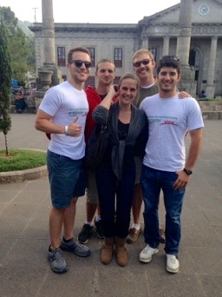
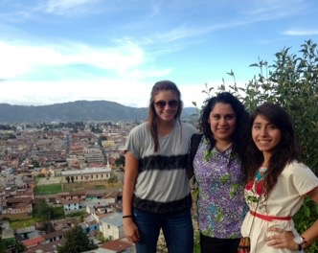
GLOVE
Updated 9/2
Global Leaders on Valuable Efficacy

Slide 2
Our Purpose
We seek to alleviate, empower and support medical teams abroad.
Focus on assisting low-income and/or underrepresented students at Texas A&M to travel on a medical service trip for free or at a low cost.
We are a recognized student organization through the Student Activities center at TAMU.
This year, we plan to send 10-12 students.

Slide 3
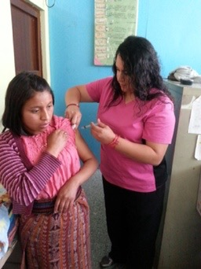
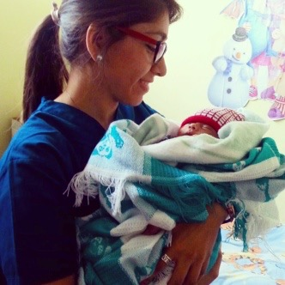
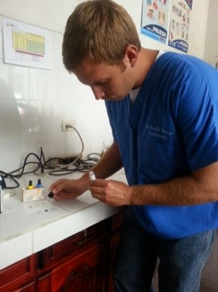
In past years…
Traveled to Quetzaltenango (Xela), Guatemala, for 2 weeks through a non-profit organization in 2014, as well as in 2015.
Volunteered in El Centro de Salud (Health center) Fundabiem (Therapy center), Hospital Nacional Dr. Rodolfo Robles (Hospital)

Slide 4
Document Requirements
A visa is not required for a stay of up to 90 days.
Traveler must be in possession of:
a passport valid for 6 months beyond stay.
a round-trip airline ticket.

Slide 5
Passport
It is the applicants responsibility to be in possession of a current, valid passport and the funds required to procure it.
A copy of the original and signed passport must be sent in with all required documents for the application.
It is the responsibility of the individual to pay for passport renewal or procurement.
A passport can be ordered through the Study Abroad Office.

Slide 6
Vaccinations
Vaccines for travel to La Ceiba. Honduras (2018 destination):
Up to date routine vaccinations
Typhoid (if desired)
Hepatitis A (if desired)
https://wwwnc.cdc.gov/travel/destinations/traveler/none/honduras
Consult your local travel doctor about the requirements for vaccines in Honduras
Can also go by Beutal for vaccines
It is the responsibility of the individual to pay for all vaccines if desired

Slide 7
Traveler's Insurance
We will be purchasing Traveler’s Insurance through the Texas A&M Study Abroad Office. This will be done once accepted into the organization. The cost is usually $30 or less.

Slide 8
Program Dates/Details
We will be leaving from the US on January 1st, 2018.
We will arriving back to the US on January 14th, 2018.
Bus transportation will take participants to and from the airport in San Pedro Sula, Honduras.
We will be staying with a host family in La Ceiba.

Slide 9
Program Details
Program Schedule
Program starts and ends in La Ceiba, Honduras.
Airport meet and greet in San Pedro Sula, Honduras upon arrival.
Monday to Friday volunteering (40 hours per week).
Example shift times: 8am-12 pm and 2pm-6pm
Weekends are free for sightseeing.
Volunteers can rotate between departments, help in the pharmacy, laboratory and checkups, maternity, clean wounds, give sutures, and participate on daily rounds with the medical staff, and hands on work with patients in the second week.

Slide 10
Costs
Cost of Program:
$1045 + Airline ticket (<$300) + TAMU Traveler’s Insurance (<$30)
Personal spending money
Passport/insurance personal costs
This price will be reduced through available organization money and fundraising.

Slide 11
Applying to GLOVE
Application
View/download on our website glovetamu.weebly.com
A copy of your FAFSA information
Copy of Passport
In-person Interview.
Email all documents to glovetamu@gmail.com

Slide 12
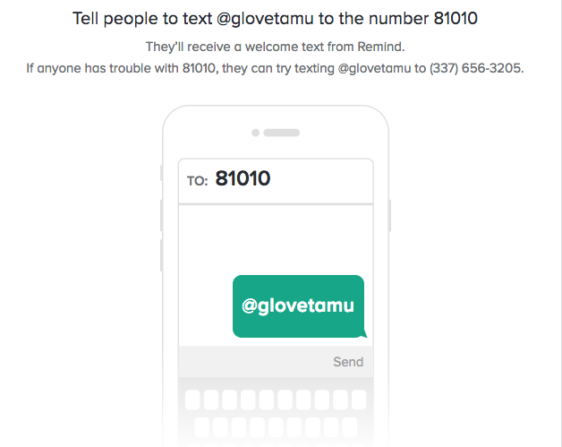
Dates to Remember
All application documents are due September 22, 2017.

Slide 13
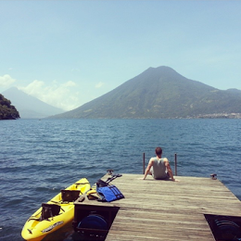
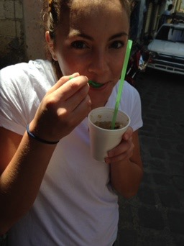
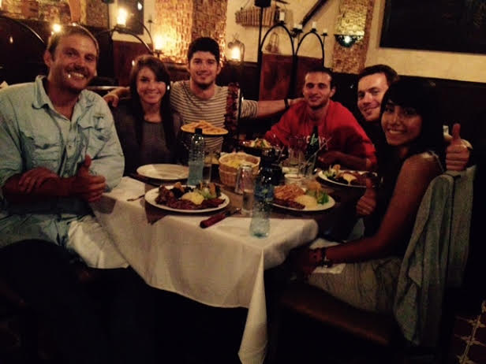
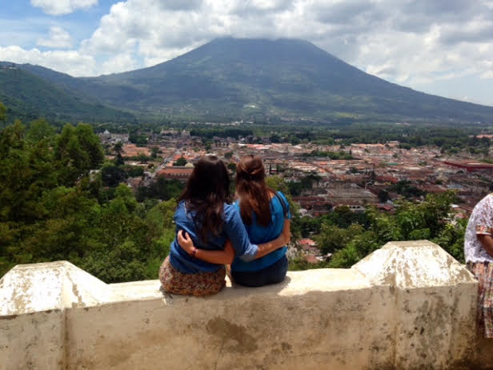
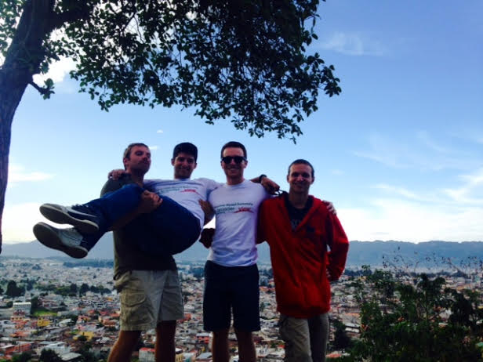

Slide 14
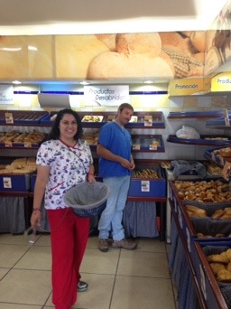
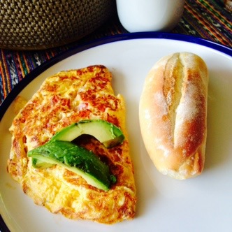
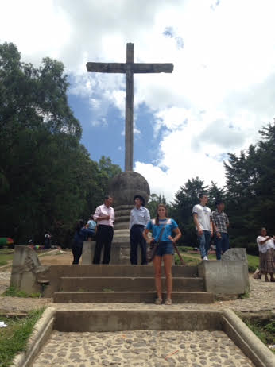
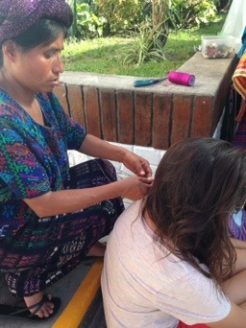
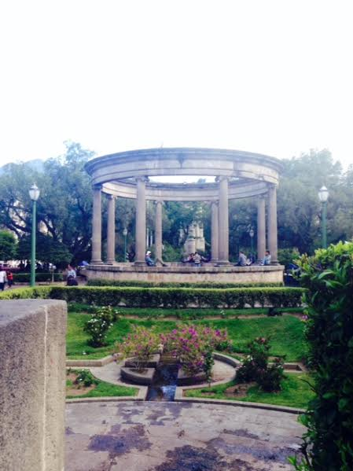
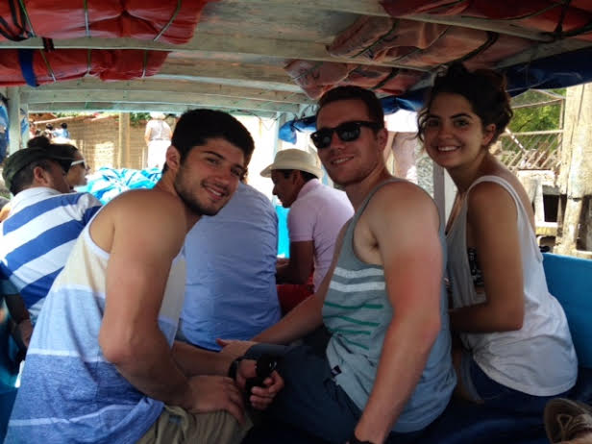

Slide 15
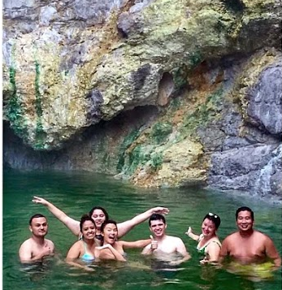
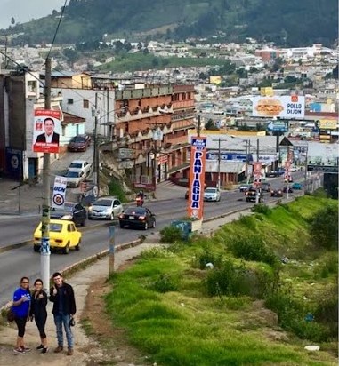
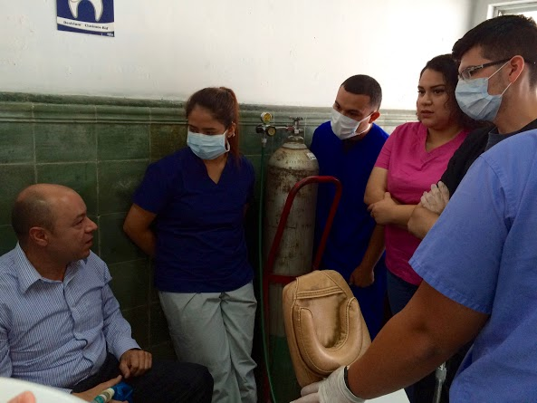
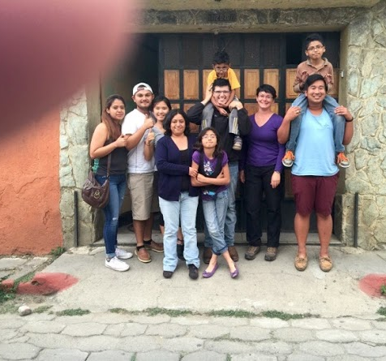
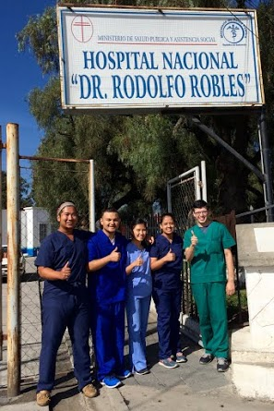
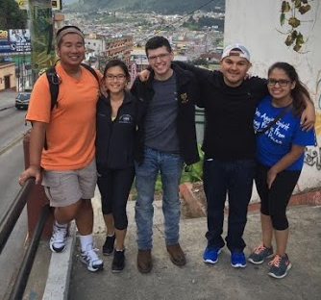

Slide 16
